Slide 1
Twitter sentimental Analysis

Slide 2
AGENDA
Abstract
Data Set
Existing Model
Proposal Model
Summary​

Slide 3
Abstract
In the realm of Natural Language Processing (NLP), sentiment analysis plays a crucial role in gauging public opinion and understanding the sentiment behind textual data. One of the most compelling applications of sentiment analysis is in the context of the US Election, where public sentiment can sway significantly and have far-reaching implications. In this project, we aim to delve into sentiment analysis specifically tailored for the US Election context. Building upon existing models, we propose enhancements and novel approaches to better capture nuanced sentiments and provide deeper insights into voter sentiment dynamics.

Slide 4
Data Set
For our project, we will leverage a comprehensive dataset comprising social media posts, news articles, and public forums discussions related to the US Election.
The dataset will encompass a diverse range of sources to capture a holistic view of public sentiment.
We will preprocess the data to remove noise, handle missing values, and ensure consistency in the text format for accurate sentiment analysis.

Slide 5
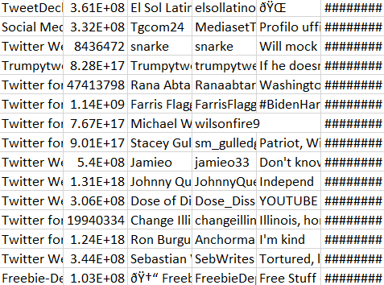
US Election 2020 Tweets

Slide 6
Existing model
Prior to proposing our enhancements, we will review existing sentiment analysis models commonly applied to political discourse, particularly focusing on the US Election.
We will explore the methodologies, strengths, and limitations of these models.
Commonly used techniques such as Bag-of-Words (BoW), Word Embeddings, and Recurrent Neural Networks (RNNs) will be analyzed in the context of their effectiveness in capturing nuanced political sentiments

Slide 7
Proposal model
Our proposed model will incorporate advanced NLP techniques to enhance sentiment analysis accuracy and depth.
We will explore the integration of contextual embeddings such as BERT (Bidirectional Encoder Representations from Transformers) to better capture the contextual nuances and complexities of political discourse.
Additionally, we will incorporate sentiment lexicons tailored specifically for political sentiment analysis to improve model performance.

Slide 8
Summary
In conclusion, our project aims to contribute to the field of sentiment analysis by providing a robust framework tailored specifically for analyzing sentiment dynamics in the context of the US Election.
By leveraging advanced NLP techniques and incorporating domain-specific knowledge, we aim to provide deeper insights into public opinion, thus enabling stakeholders to make more informed decisions.
Our proposed model not only enhances sentiment analysis accuracy but also provides a foundation for understanding the underlying factors driving voter sentiment, thereby contributing to a deeper understanding of the democratic process.

Slide 9
Meet the team
Bhoomika Kasireddy
Guru SubhashBathula

Slide 10
Thank you

